Slide 1
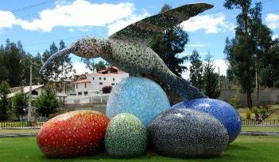

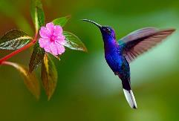
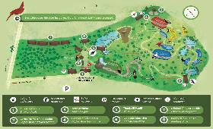
ENERO / JANUARY 2019
LUNES MONDAY | MARTES TUESDAY | MIÉRCOLES WEDNESDAY | JUEVES THURSDAY | VIERNES FRIDAY | SÁBADO SATURDAY | DOMINGO SUNDAY
 | 1 First | 2 Second | 3 Third | 4 Fourth | 5 Fifth | 6 sixth
7 Seventh | 8 Eighth | 9 Ninth | 10 Tenth | 11 Eleventh | 12 twelfth | 13 thirteenth
14 fourteenth | 15 Fifteenth | 16 sixteenth | 17 seventeenth | 18 Eighteenth | 19 Nineteenth | 20 Twentieth
21 Twenty-first | 22 Twenty- second | 23 Twenty third | 24 Twenty-fourth | 25 Twenty-fifth | 26 Twenty-sixth | 27 Twenty-seventh
28 Twenty- eighth | 29 Twenty-ninth | 30 Thirtieth | 31 Thirty-first
Gracias al buen clima que hace en San Francisquito durante todo el año, tenemos la oportunidad de tener una gran variedad de flores durante los doce mese del año, lo cual brinda a los colibrís el habitad perfecta para que puedan subsistir y por esto podemos disfrutar de su hermosa presencia, por lo cual se decidió conmemorar un día para celebrarlo.
Thanks to the good climate that makes in San Francisquito throughout the year, we have the opportunity to have a wide variety of flowers during the twelve months of the year, which gives hummingbirds the perfect habitat for them to survive and therefore we can enjoy its beautiful presence, for which it was decided to commemorate a day to celebrate it.
El noveno día de enero se celebra el maravilloso día del colibrí
Ruta a los monumentos de las aves
The ninth day of January is celebrated the wonderful day of the hummingbird
Route to the monuments of the birds

Slide 2
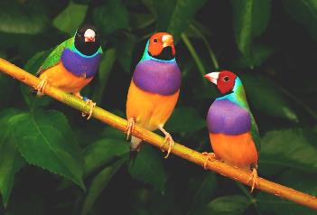
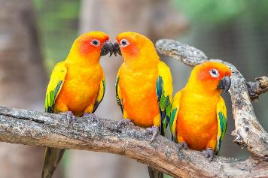
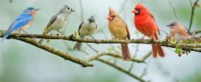

FEBRERO / FEBRUARY 2019 Mes de las aves/ Month of the birds
LUNES MONDAY | MARTES TUESDAY | MIÉRCOLES WEDNESDAY | JUEVES THURSDAY | VIERNES FRIDAY | SÁBADO SATURDAY | DOMINGO SUNDAY
 |  |  |  | 1 First | 2 Second | 3 Third
4 Fourth | 5 Fifth | 6 sixth | 7 Seventh | 8 Eighth | 9 Ninth | 10 Tenth
11 Eleventh | 12 twelfth | 13 thirteenth | 14 fourteenth | 15 Fifteenth | 16 sixteenth | 17 seventeenth
18 Eighteenth | 19 Nineteenth | 20 Twentieth | 21 Twenty-first | 22 Twenty- second | 23 Twenty third | 24 Twenty-fourth
25 Twenty-fifth | 26 Twenty-sixth | 27 Twenty-seventh | 28 Twenty- eighth
¿TE GUSTAN LAS AVES?
DO YOU LIKE BIRDS?
DISFRUTA EN FEBRERO EL MES DE LAS AVES
ENJOY IN FEBRUARY THE MONTH OF THE BIRDS

